Slide 1
STOR 455 Final Cheat Sheet
Cameron Kaplinger

Slide 2
Types of Variables
Quantitative: expressible as numbers for which arithmetic makes sense
Categorical: divides sample points into groups
Binary = categorical with just two groups

Slide 3
Building a Statistical Model: Four Step Process
1. CHOOSE – Pick a form for the model
2. FIT – Estimate any parameters
3. ASSESS – Is the model adequate? Could it be simpler? Are conditions met?
4. USE – Answer the question of interest

Slide 4
Simple Linear Model- Conditions
Model:
Linearity: The means for Y vary as a linear function of X.
Error:
Zero Mean: The distribution of the errors is centered at zero.
Constant variance: The variance for Y is the same at each X. (Homoscedasticity)
Independence: No relationships among errors.
Normality:
Residuals are normally distributed
(sometimes) At each X, the Y’s follow a normal distribution.

Slide 5
Types of “Unusual” Points in SLM
Outlier: A data point that is far from the regression line.
Influential point: A data point that has a large effect on the regression fit.
How do we measure “far”?
How do we measure “effect on the fit”?

Slide 6
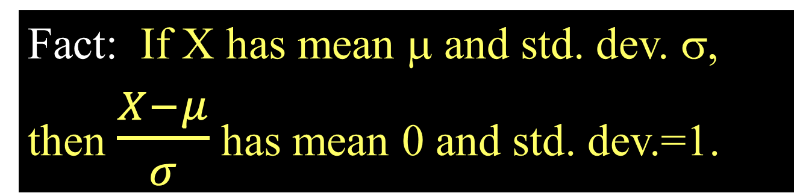

Standardized Residuals
Fact: If X has mean μ and std. dev. σ,
then $\frac{X−μ}{σ}$ has mean 0 and std. dev.=1.
For residuals: mean=0 and std. dev. $≈{\hat{σ}}_{ε}$
Standardized
Residual ≈
Look for values
beyond ±2 (mild) or beyond ±3
(almost)

Slide 7
Standardized Residuals in R
Once you have fit mymodel=lm(Y~X)
Use: rstandard(mymodel)
GoldModel=lm(Gold~Year,data=LongJumpOlympics2016)
rstandard(GoldModel)
1 2 3 4 5 6
-0.45846037 -0.02447194 -0.69927805 0.34245659 0.62395356 -1.58872766
7 8 9 10 11 12
-0.60354515 0.33349306 -0.22282237 1.24041457 -0.28038843 -1.47783119
13 14 15 16 17 18
-0.65303672 0.28865616 -0.10391829 2.96025507 0.17095826 0.40756162
19 20 21 22 23 24
0.96124413 0.76569814 1.28443310 0.89029407 0.01303494 0.01295953
25 26 27 28
-0.02754601 -1.24791995 -1.58338033 -1.51206192
max(rstandard(GoldModel))
[1] 3.02588100

Slide 8

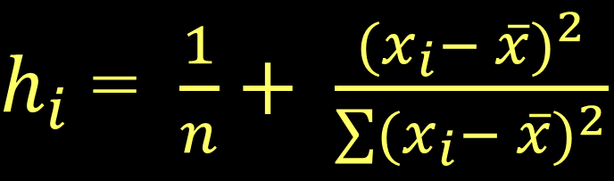


Typical Leverage
$h_{i}$ = $\frac{1}{n}+ \frac{{(x_{i}− \overline{x})}^{2}}{\sum{{(x_{i}− \overline{x})}^{2}}}$
For a simple linear model:
= 1+ 1 = 2
Look for:
$h_{i}$ > $2( \frac{2}{n} )$
or
$h_{i}$ > $3( \frac{2}{n} )$

Slide 9
Leverage
2*(2/28)
3*(2/28)
sort(hatvalues(GoldModel), decreasing = TRUE)
[1] 0.1428571
[1] 0.2142857
1 28 2 27 3 4 26
0.13075010 0.12573712 0.11825693 0.11358967 0.11234035 0.10664378 0.10232224
5 25 24 6 23 7 22
0.09591065 0.09193483 0.08242745 0.07708445 0.07380009 0.06899139 0.06605275
8 21 9 20 10 19 18
0.06177835 0.05918543 0.05544533 0.05319813 0.04999234 0.04809086 0.04386361
17 11 16 12 15 13 14
0.04051638 0.03891349 0.03804918 0.03698058 0.03646200 0.03592770 0.03575484

Slide 10
Cook’s Distance
How much would the fit change if one data value were omitted?
k is the number of predictors. In SLM k=1.
D_{i} increases with either poor fit (std.res_{i}) and high leverage (h_{i}).
Compare to other D_{i}’s.
Study any case with D_{i} > 0.5; worry if D_{i} > 1.0.

Slide 11
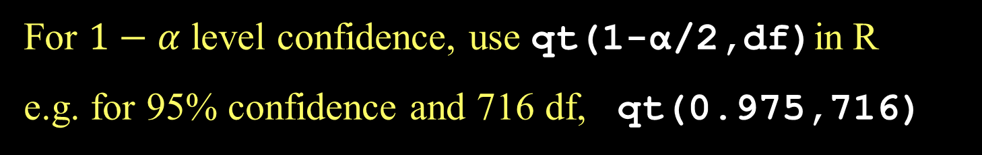
CI for Slope or Intercept
t* comes from a t-distribution with n-2 d.f and depends on the level of confidence
For $1−α$ level confidence, use qt(1-α/2,df)in R
e.g. for 95% confidence and 716 df, qt(0.975,716)

Slide 12
How to find a confidence interval?
confint(mymodel,level =0.XX) and adjust for the confidence level.
2.5 % 97.5 %
(Intercept) 2.253166766 2.368979914
Pieces 0.002052779 0.002407299

Slide 13
CI and PI via R when X=x*
newx=data.frame(Pieces=127)
predict.lm(modlego2, newx, interval="confidence")
predict.lm(modlego2, newx, interval="prediction")
fit lwr upr
1 2.594288 2.551976 2.636601
fit lwr upr
1 2.594288 1.649688 3.538888

Slide 14
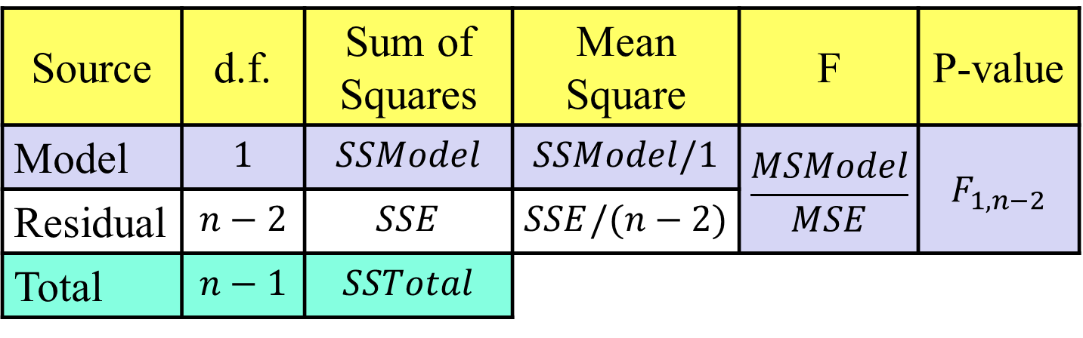


ANOVA Test for Regression
H_{o}: β₁ = 0
H_{a}: β₁ ≠ 0
vs.
($\overline{y}$)
($\hat{y}$)
Source | d.f. | Sum of Squares | Mean Square | F | P-value
Model | $$1$$ | $$SSModel$$ | $$SSModel/1$$ | $$\frac{MSModel}{MSE}$$ | $$F_{1,n−2}$$
Residual | $$n−2$$ | $$SSE$$ | $$SSE/(n−2)$$
Total | $$n−1$$ | $$SSTotal$$
in R use 1-pf(Fstat,1,n-2)

Slide 15
T-test for slope:
Which is best?
H_{o}: β₁=0
H_{a}: β₁≠0
Compare to t _{n-2}
All three are equivalent!
ANOVA for regression:
H_{o}: β₁=0
H_{a}: β₁≠0
Compare to F_{1,n-2}
T-test for correlation:
(t_{n-2})² = F_{1,n-2}
H_{o}: ρ =0
H_{a}: ρ ≠0
Compare to t _{n-2}

Slide 16
Three Regression Tests in R
Why 3 different tests?
Multiple regression
> summary(modlego2)
Coefficients:
Estimate Std. Error t value Pr(>|t|)
(Intercept) 2.311e+00 2.949e-02 78.36 <2e-16 ***
Pieces 2.230e-03 9.029e-05 24.70 <2e-16 ***
anova(modlego2)
Df Sum Sq Mean Sq F value Pr(>F)
Pieces 1 140.94 140.938 610.06 < 2.2e-16 ***
Residuals 716 165.41 0.231
cor.test(lego_under_800_pieces$Pieces, lego_under_800_pieces$Amazon_Price^(0.3))
t = 24.699, df = 716, p-value < 2.2e-16

Slide 17
Coefficient of Multiple Determination
Now interpreted as the % of variability in the response variable (Y) that is “explained” by a linear combination of these predictors.

Slide 18
t-test for Correlation vs. t-test for Slope
t-test for correlation: Assesses the linear association between two variables by themselves.
t-test for slope: Assesses the linear association after accounting for the other predictors in the model.

Slide 19
Multicollinearity
What is it?
When two or more predictors are strongly associated with each other.
Why is it a problem?
Individual coefficients and t-tests can be deceptive and unreliable.

Slide 20
Effects of Multicollinearity
If predictors are highly correlated among themselves:
The regression coefficients and tests can be extremely variable and difficult to interpret individually.
One variable alone might work as well as many.

Slide 21
How do we detect multicollinearity?
Look at a correlation matrix of the predictors.
> round(cor(Houses),2)
Price Size Lot
Price 1.00 0.68 0.72
Size 0.68 1.00 0.77
Lot 0.72 0.77 1.00

Slide 22
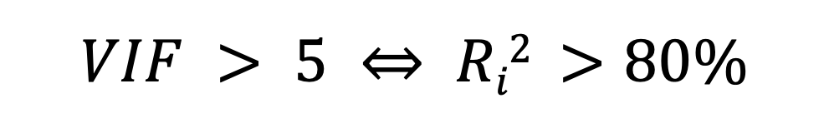
How do we detect multicollinearity?
Look at a correlation matrix of the predictors.
Compute the Variance Inflation Factor (VIF).
(Beware if VIF > 5)
where R_{i}² is for predicting X_{i} with the other predictors.
$$VIF > 5 ⇔ Ri2 >80\%$$

Slide 23
Finding VIF with R
2. Install car package
use vif( )function
> vif(HouseModel)
Size Lot
2.427732 2.427732

Slide 24
What to do if you’ve got Multicollinearity?
Choose a better set of predictors
Eliminate some of the redundant predictors to leave a more independent set.
Combine predictors into a scale.
“Ignore” the individual coefficients and tests.
Note: Predictions aren’t necessarily worse if some predictors are related – it’s just conclusions about individual terms that might be confused.

Slide 25
Criteria to Compare Models?
Look for large R²
But R² is always best for the model with all predictors
Look for large adjusted R²
Helps factor in the number of predictors in the model
Look at individual t-tests
Might be susceptible to multicollinearity problems

Slide 26
How to Choose Models to Compare?
Method #1:
All Subsets!
Consider all possible combinations of predictors.
How many are there?
Pool of k predictors ⇒
$2k−1$ subsets
Advantage: Find the best model for your criteria
Disadvantage: LOTS of computation

Slide 27
R: Best Subsets for Bodyfat
#requires the leaps package
library(leaps)
#Ask for the models of each size (up to 8 predictors)
all = regsubsets(Bodyfat~., data = BodyFat)
#show the predictors in “best” models of various sizes
summary(all)

Slide 28

Mallows’ C_{p}
Note: R², Adjusted R², SSE, all depend only on the predictors in the model being evaluated – NOT the other potential predictors in the pool.
Mallow’s C_{p}: When evaluating a subset of m predictors from a larger set of k predictors,
reduced
full
m = # predictors in the reduced model

Slide 29
Example
A full model with 100 observations and 9 predictors has an MSE of 17.1065. The regression with a subset of 4 predictors has an SSE of 1561.317. What is the Mallows’ Cp for this subset of predictors?
1561.317 / 17.1065 + 2(4+1) – 100 = 1.27039

Slide 30
Notes on C_{p}
C_{p} depends on the larger pool of predictors as well as the set being considered.
For full model ⇒
C_{p} = k+1
For a “good” set of predictor, C_{p} should be small.
Like Adj R², C_{p} weighs both the effectiveness of the model (SSE_{m}) and the # of predictors (m).

Slide 31
Predictor Selection Methods
Choosing an effective set of predictors
Think, consult, graph… but if that fails, then:
All subsets
Backward elimination
Forward selection
Stepwise regression

Slide 32
Backward Elimination
Start with the full model (all predictors)
Calculate if the model would be “better” by removing each of the predictor individually
Find the “least significant” predictor
Does removing the predictor create a “better” model?
No ⇒ Keep the predictor & stop
Yes ⇒ Delete the predictor and go back to step 2 with the reduced model.

Slide 33
Backward Elimination
Advantages:
Removes “worst” predictors early
Relatively few models to consider
Leaves only “important” predictors
Disadvantages:
Most complicated models first
Individual t-tests may be unstable
Susceptible to multicollinearity

Slide 34
Backward Elimination in R
# Fit the full model
Full = lm(Bodyfat~., data = BodyFat)
# Find the MSE for the full model
MSE=(summary(Full)$sigma)^2
# Backward: use the step( ) function starting with the full model
step(Full,scale=MSE)
#R uses Cp (AIC) to pick next model

Slide 35
Forward Selection
Start with the best single predictor
2. Is that predictor significant?
Yes ⇒ Include predictor in the model
No ⇒ Don’t include predictor & stop
Find the “most significant” new predictor from among those NOT in the model. Return to step 2.

Slide 36
Forward Selection
Advantages:
Uses smaller models early (parsimony)
Less susceptible to multicollinearity
Shows “most important” predictors
Disadvantages:
Need to consider more models
Predictor entered early may become redundant later

Slide 37
Forward Selection in R
# Fit the full model
Full = lm(Bodyfat~., data = BodyFat)
# Find the MSE for the full model
MSE=(summary(Full)$sigma)^2
# Start with a model with NO predictors
none = lm(Bodyfat~1, data=BodyFat)
#Specify the direction
step(none, scope=list(upper=Full), scale=MSE, direction=“forward”)
start
predictor pool

Slide 38
Stepwise Regression
Basic idea: Alternate forward selection and backward elimination
Use forward selection to choose a new predictor and check its significance.
Use backward elimination to see if predictors already in the model can be dropped.

Slide 39
Stepwise in R
# Fit the full model
Full = lm(Bodyfat~., data = BodyFat)
# Find the MSE for the full model
MSE=(summary(Full)$sigma)^2
# Start with a model with NO predictors
none = lm(Bodyfat~1, data=BodyFat)
# Don’t specify a direction
step(none,scope=list(upper=Full),scale=MSE)

Slide 40
This is everything up to Midterm 1. If something can’t be found, look at lecture 13

Slide 41
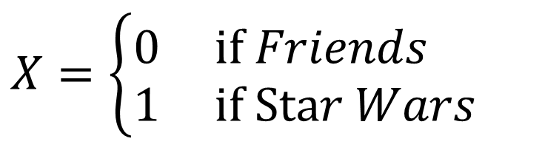
Coding “Dummy” Predictors
We can code a categorical predictor as (0,1)
How should this be interpreted in a regression?
Example: Y = Amazon Price
$$X=\left\{\begin{aligned}&0 \text{if} Friends \\ &1 \text{if} \text{Sta}r Wars\end{aligned}\right.$$

Slide 42
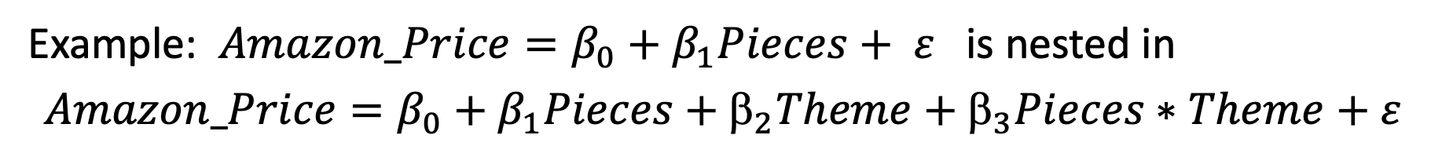
Nested Models
Definition: If all of the predictors in Model A are also in a bigger Model B, we say that Model A is nested in Model B.
Example: $Amazon_Price=β_{0}+β_{1}Pieces+ ε$ is nested in
$$Amazon_Price=β_{0}+β_{1}Pieces+_{2}Theme+_{3}Pieces∗Theme+ε$$
Test for Nested Models:
Do we really need the extra terms in Model B?
i.e. How much do they “add” to Model A?

Slide 43
Nested F-test
Basic idea:
1. Find how much “extra” variability is explained when the “new” terms being tested are added.
2. Divide by the number of new terms to get a mean square for the new part of the model.
3. Divide this mean square by the MSE for the “full” model to get an F-statistic.
4. Compare to an F-distribution to find a p-value.

Slide 44
Nested F-test
$$Amazon_Price=β_{0}+β_{1}Pieces+_{2}Theme+_{3}Pieces∗Theme+ε$$
H₀: β₂=β₃=0
H_{a}: Some β_{i}≠0
Compare mean square for the “extra” variability to the mean square error for the full model.
anova(modlego_Reduced, modlegoint)
Analysis of Variance Table
Model 1: Amazon_Price ~ Pieces
Model 2: Amazon_Price ~ Pieces + Theme + Pieces * Theme
Res.Df RSS Df Sum of Sq F Pr(>F)
1 181 247273
2 179 236943 2 10330 3.902 0.02194 *

Slide 45
Polynomial Regression in R
Method #1: Create new variables with predictor powers.
StateSAT$TakersSq=StateSAT$Takers^2
modSATquad1=lm(SAT~Takers+TakersSq,data=StateSAT)
To avoid creating a new variable…
Method #2: Use I( )in the lm( )
modSATquad2=lm(SAT~Takers+I(Takers^2),data=StateSAT)
Method #3: Use poly
modSATquad3=lm(SAT~poly(Takers,degree=2,raw=TRUE), data=StateSAT)

Slide 46
Cross Validation
Concern: A model may reflect the structure of a particular sample, but not generalize well to the population.
To see if this is a problem:
Split the original sample into two parts
(a) A “training” sample to build a model
(b) A “holdout” sample to test the model

Slide 47
Example: Active Pulse Rates
Training sample – first 300 cases (PulseTrain)
Holdout sample – #301-375 (PulseHoldout)
set.seed(12345)
rows <- sample(nrow(Pulse))
Pulse_shuffled = Pulse [rows,]
PulseTrain= Pulse_shuffled [1:300,]
PulseHoldout= Pulse_shuffled [301:375,]
What is the best model to predict Active pulse?

Slide 48
Cross Validation Correlation and Shrinkage
Compute the correlation between predicted and actual response values for the holdout sample. This is known as the cross validation correlation.
cor(PulseHoldout$Active,fitActive)
[1] 0.6474953

Slide 49
Shrinkage
Square the correlation to get a cross validation R² and compare it to R² for the training sample
Since the model was optimized for the training sample, we expect less R² for the holdout.
The difference (Training R² – Holdout R²) is known as shrinkage.
crosscorr=cor(PulseHoldout$Active,fitActive)
crosscorr
[1] 0.6474953
crosscorr^2
[1] 0.4192502
0.4216-crosscorr^2
[1] 0.002325805
The shrinkage (0.0023) is great. The training model seemed to perform as well on the holdout sample as it did on the data it was optimized for.

Slide 50
Leverage in Multiple Regression
For a multiple regression with k predictors:
Look for:
or

Slide 51
Categorical Response Variables
Examples:
Political preference
Nominal response
Three “flavors” of logistic regression:
binary
ordinal
nominal

Slide 52
Binary Logistic Regression Model
Y = Binary response
X = Quantitative predictor
π = proportion of 1’s (yes, success,…) at any x
Modeling the probability of success instead!

Slide 53
Binary Logistic Regression Model
Y = Binary response
X = Quantitative predictor
π = proportion of 1’s (yes, success,…) at any x
Probability form
Logit form
Linear Model

Slide 54
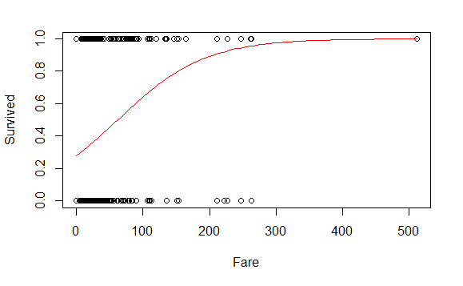
Titanic_logitmod = glm(Survived ~ Fare, family = binomial, data=titanic_train)
plot(Survived ~ Fare, data=titanic_train)
B0 = summary(Titanic_logitmod )$coef[1]
B1 = summary(Titanic_logitmod )$coef[2]
curve(exp(B0+B1*x)/(1+exp(B0+B1*x)),add=TRUE, col="red")

Slide 55

Odds
The odds against a certain horse winning a race are 4 to 1. What does that mean?
P(Win)=1/5
4 losses for every 1 win
P(Loss)=4/5
$$Odds= \frac{P(Win)}{P(Loss)}=\frac{1/5}{4/5}=\frac{1}{4}$$

Slide 56
Example 3
If the odds are 2. What is the chance of winning? 33%

Slide 57
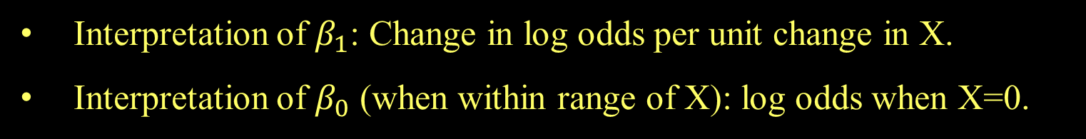
Odds and Logistic Regression
Logit form:
⇒
The logistic model assumes a linear relationship between the predictor and log(odds).
Interpretation of $β_{1}$: Change in log odds per unit change in X.
Interpretation of $β_{0}$ (when within range of X): log odds when X=0.

Slide 58
Odds Ratio
A common way to compare two groups is to look at the ratio of their odds

Slide 59
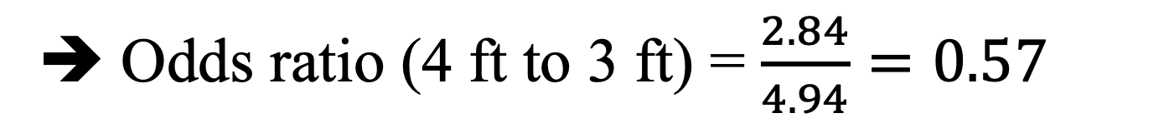
Putting Data
Odds using data from 4 feet = 2.84
Odds using data from 3 feet = 4.94
➔ Odds ratio (4 ft to 3 ft) = $\frac{2.84}{4.94}=0.57$
The odds of making a putt from 4 feet are 57% of the odds of making from 3 feet.

Slide 60
Everything up to Midterm 2, If something can’t be found, look at lecture 20

Slide 61
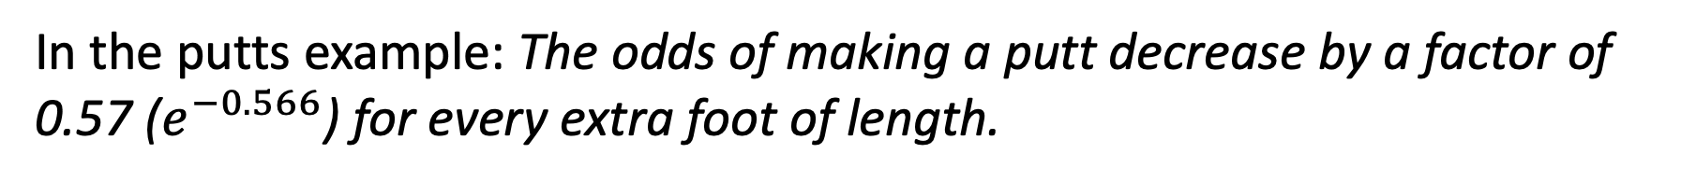

Interpreting “Slope” using Odds Ratio
⇒
What happens when we increase x by one?
$$e^{β_{0}+β_{1}(x+1)}=e^{β_{0}+β_{1}x}∙e^{β_{1}}$$
When we increase x by one, the odds increase/decrease by a multiplicative factor of $e^{β_{1}}$ (odds ratio).
In the putts example: The odds of making a putt decrease by a factor of 0.57 ($e^{−0.566}$) for every extra foot of length.

Slide 62

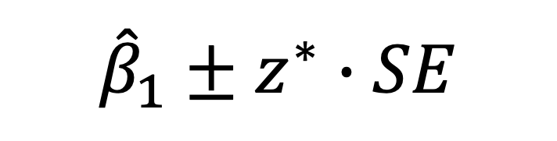



CI for Slope and Odds Ratio
Using the SE for the slope, find a CI for β₁ with
$${\hat{β}}_{1}±z^{∗}∙SE$$
To get CI for the odds ratio ($e^{β_{1}})$ exponentiate the CI for β₁
Estimate Std. Error z value Pr(>|z|)
(Intercept) 3.25684 0.36893 8.828 <2e-16 ***
Length -0.56614 0.06747 -8.391 <2e-16 ***
CI for slope:
$$−0.566±1.96(0.06747)$$
$$=(−0.698,−0.434)$$
CI for OR:
$${(e}^{−0.698},e^{−0.438})$$
$$=(0.497, 0.648)$$

Slide 63

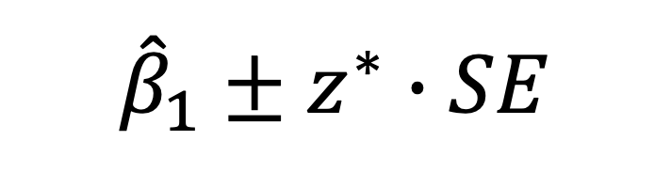

CI for Slope and Odds Ratio
Using the SE for the slope, find a CI for β₁ with
$${\hat{β}}_{1}±z^{∗}∙SE$$
SE_B1 = summary(modPutt)$coef[2,2]
exp(B1 - SE_B1*qnorm(0.975))
exp(B1 + SE_B1*qnorm(0.975))
[1] 0.4973894
[1] 0.6479761
exp(confint.default(modPutt))
2.5 % 97.5 %
(Intercept) 12.6006177 53.5133410
Length 0.4973894 0.6479761
CI for OR:
$${(e}^{−0.698},e^{−0.438})$$
$$=(0.497, 0.648)$$

Slide 64
Putts1: Made~Length
lmodPutt=glm(Made~Length,family=binomial,data=Putts1)
summary(lmodPutt)
Coefficients:
Estimate Std. Error z value Pr(>|z|)
(Intercept) 3.25684 0.36893 8.828 <2e-16
Length -0.56614 0.06747 -8.391 <2e-16
Null deviance: 800.21 on 586 degrees of freedom
Residual deviance: 719.89 on 585 degrees of freedom
Notes:
The important number is the difference between the null deviance and the residual deviance

Slide 65
Evaluating Overall Fit
H_{o}: β_{i} = 0
H_{a}: β_{i} ≠ 0
Null deviance: 800.21 on 586 degrees of freedom
Residual deviance: 719.89 on 585 degrees of freedom
$$G=800.2−719.9=80.3$$
1-pchisq(80.3,1)
[1] 0
anova(modPutt, test="Chisq")
Df Deviance Resid. Df Resid. Dev Pr(>Chi)
NULL 586 800.21
Length 1 80.317 585 719.89 < 2.2e-16 ***
Notes:
Deviance is the g-stat

Slide 66
Comparing Full to Reduced Models
ICUmod.4 = glm(Survive~factor(AgeGroup)+Emergency, data=ICU, family=binomial)
Null deviance: 200.16 on 199 degrees of freedom
Residual deviance: 171.16 on 196 degrees of freedom
FULL
ICUmod.2 = glm(Survive~factor(AgeGroup), data=ICU, family=binomial)
Null deviance: 200.16 on 199 degrees of freedom
Residual deviance: 191.59 on 197 degrees of freedom
Reduced
$H0:β3=0$ vs. $Ha: β3 ≠ 0$
1 - pchisq(summary(ICUmod.2)$deviance - summary(ICUmod.4)$deviance, 1)
Reject H₀ (p-value= 6.187652e-06). The Emergency term significantly improves the model.
This is also often called a “Drop-in-Deviance” test.

Slide 67
bestglm for Model Selection
Requirements to use bestglm()
Only the response and possible predictor variables should be within the dataframe
MedGPA.1 = within(MedGPA, {Accept = NULL})
The response variable must be the last column in the dataframe.
MedGPA.2 = MedGPA.1[,c(2:10,1)]

Slide 68
Bayesian Information Criteria
n : sample size
k : number of predictors
θ : set of all parameters.
L(θ̂) :probability of obtaining the data which you have, supposing the model being tested was a given.
k log(n)- 2log(L(θ̂))
Selection criteria, similar to Mallow’s Cp
Smaller values indicate preferred models

Slide 69
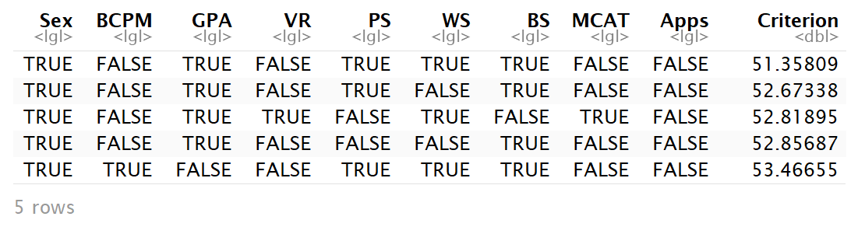
Comparing Models by BIC
ΔBIC | Evidence against higher BIC
0 to 2 | Little
2 to 6 | Positive
6 to 10 | Strong
>10 | Very strong
MedGPA.2.bestglm = bestglm(MedGPA.2, family=binomial)
MedGPA.2.bestglm$BestModels

Slide 70
ANOVA Table (for K Group Means)
H_{o}: μ₁ = μ₂= … = μ_{K}
H_{a}: Some μ_{i} ≠μ_{j}
Small P-value ➔ Reject H_{o} ➔ There is a significant difference among the means of the K groups

Slide 71
ANOVA Output in R
amodG=aov(Grade~factor(Exam),data=Exams4)
amodG
Call:
aov(formula = Grade ~ factor(Exam), data=Exams4)
Terms:
factor(Exam) Residuals
Sum of Squares 1030 5200
Deg. of Freedom 3 16
Residual standard error: 18.02776
Estimated effects may be unbalanced
summary(amodG)
Df Sum Sq Mean Sq F value Pr(>F)
factor(Exam) 3 1030.0 343.3 1.0564 0.395
Residuals 16 5200.0 325.0

Slide 72
Checking Conditions for ANOVA
Check with residuals
Zero mean:
Always holds for sample residuals
Constant variance:
Plot residuals vs. fits and/or compare std. dev.’s of groups (Check if some group s_{i} is more than twice another).
Normality:
Histogram/normal plot of residuals
Independence:
Pay attention to data collection

Slide 73
Problem of Multiplicity
When doing many pairwise comparisons
⇒ likely to make a Type I error (find a false difference)
In the cartoon, even if there is no relationship between the color and acne, the chance of seeing at least one 0.05 significant test out of 20 independent tests is
1-(1-0.05)^20 =64%!
Possible fixes:
Do only a few pre-planned comparisons
Adjust the significance level used for each test.

Slide 74

Bonferroni Significant Difference
> tapply(Exams4$Grade,Exams4$Student,mean)
Barb Betsy Bill Bob Bud
75 91 79 83 47
> mod2=aov(Grade~Student,data-Exams4)
> summary(mod2)
Df Sum Sq Mean Sq F value Pr(>F)
Student 4 4480 1120.00 9.6 0.0004676 ***
Residuals 15 1750 116.67
Bud’s mean grade is sig. different from the other four.
10 comparisons ⇒ use $α=\frac{0.05}{10}=0.005$ for each test
$$BSD=3.286\sqrt{116.67}\sqrt{\frac{1}{4}+\frac{1}{4}}=25.1$$
t* for 99.5% (3.286)

Slide 75
Tukey’s HSD (Honestly Significant Difference)
Replace t* with a value q* from the studentized range distribution (use R).
Depends on α, # groups=K, and error d.f.
R: use qtukey(1-α, K, n-K)

Slide 76

ANOVA for Grades vs. Students
> tapply(Exams4$Grade,Exams4$Student,mean)
Barb Betsy Bill Bob Bud
75 91 79 83 47
> mod2=aov(Grade~Student,data-Exams4)
> summary(mod2)
Df Sum Sq Mean Sq F value Pr(>F)
Student 4 4480 1120.00 9.6 0.0004676 ***
Residuals 15 1750 116.67
> qtukey(1-0.05,5,15)
4.366985
Bud’s mean grade is sig. different from the other four.
$$HSD=\frac{4.37}{\sqrt{2}}\sqrt{116.67}\sqrt{\frac{1}{4}+\frac{1}{4}}=$$
$$3.088\sqrt{116.67}\sqrt{\frac{1}{4}+\frac{1}{4}}=23.6$$

Slide 77
LSD and BSD in R
#To get pairwise tests using Fisher's LSD
> pairwise.t.test(Exams4$Grade,Exams4$Student,p.adj="none")
Barb Betsy Bill Bob
Betsy 0.05357 - - -
Bill 0.60812 0.13699 - -
Bob 0.31148 0.31148 0.60812 -
Bud 0.00229 3.8e-05 0.00079 0.00028
P value adjustment method: none
#To get pairwise tests using Bonferroni
> pairwise.t.test(Exams4$Grade,Exams4$Student,p.adj="bonf")
Barb Betsy Bill Bob
Betsy 0.53567 - - -
Bill 1.00000 1.00000 - -
Bob 1.00000 1.00000 1.00000 -
Bud 0.02293 0.00038 0.00789 0.00277
P value adjustment method: bonferroni
Small p-value ⇒ different group means

Slide 78
Tukey HSD via R
> TukeyHSD(modS)
Tukey multiple comparisons of means
95% family-wise confidence level
Fit: aov(formula = Grade ~ Student)
$Student
diff lwr upr p adj
Betsy-Barb 16 -7.584413 39.584413 0.2720310
Bill-Barb 4 -19.584413 27.584413 0.9835150
Bob-Barb 8 -15.584413 31.584413 0.8295529
Bud-Barb -28 -51.584413 -4.415587 0.0166293
Bill-Betsy -12 -35.584413 11.584413 0.5360462
Bob-Betsy -8 -31.584413 15.584413 0.8295529
Bud-Betsy -44 -67.584413 -20.415587 0.0003116
Bob-Bill 4 -19.584413 27.584413 0.9835150
Bud-Bill -32 -55.584413 -8.415587 0.0060225
Bud-Bob -36 -59.584413 -12.415587 0.0021941

Slide 79
Randomized Block ANOVA Table
K−1
SSA
SSA/(K-1)
MSA/MSE
J−1
SSB
SSB/(J-1)
MSB/MSE
(K-1)(J-1)
SSE
SSE/(K-1)(J-1)
n-1
SSTotal
Testing TWO hypotheses:
H_{o}: α₁ = α ₂=...= α_{K}=0
H_{a}: Some α _{k} ≠0
(Factor A: Difference in treatment means?)
H_{o}: β₁ = β ₂=...= β_{J}=0
H_{a}: Some β _{j} ≠0
(Factor B: Difference in block means?)

Slide 80
What’s an Interaction Effect?
An interaction effect occurs when a significant difference is present at a specific combination of factors.
Example: Y=GPA
Factor A = Year in School (FY, So, Jr, Se)
Factor B = Major (Psych, Bio, Math)
FY is hard?
⇒ α₁ < 0 (main effect)
Bio is easy?
⇒ β₂ > 0 (main effect)
Jr in Math is hard?
⇒ γ₃₃ < 0 (interaction effect)

Slide 81
Two-way ANOVA Table (with interaction)
Source | d.f. | S.S. | M.S. | t.s. | p-value
Factor A | K-1 | SSA | SSA/(K-1) | MSA/MSE
Factor B | J-1 | SSB | SSB/(J-1) | MSB/MSE
A x B | (K-1)(J-1) | SSAB | SSAB/df | MSAB/MSE
Error | JK(c-1) | SSE | SSE/df
Total | n-1 | SSY
H_{o}: All α_{k} = 0
H_{A}: Some α_{k} ≠ 0
H_{o}: All β_{J} = 0
H_{A}: Some β_{J} ≠ 0
H_{o}: All γ_{kj} =0
H_{A}: Some γ_{kj} ≠ 0

Slide 82
Interpreting Interaction
IF the two-way ANOVA indicates a significant interaction, plot the cell means vs. one factor with separate lines/symbols for the second factor
Called a Cell means plot or Interaction plot
Cell Means: | Plastic | Wood
Thin | 58.0 | 66.0
Moderate | 61.0 | 73.0
Heavy | 79.0 | 47.0
interaction.plot(FactorA,FactorB,Response)

Slide 83
Levene’s Test for Grades versus Students
medians=rep(tapply(Exams4$Grade, Exams4$Student,median),each=4)
Barb Barb Barb Barb Betsy Betsy Betsy Betsy Bill Bill Bill
75.5 75.5 75.5 75.5 91.5 91.5 91.5 91.5 77.5 77.5 77.5
Bill Bob Bob Bob Bob Bud Bud Bud Bud
77.5 82.5 82.5 82.5 82.5 48.5 48.5 48.5 48.5
LeveneData=abs(Exams4$Grade-medians)
LeveneData
Barb Barb Barb Barb Betsy Betsy Betsy Betsy Bill Bill
13.5 11.5 1.5 1.5 2.5 3.5 5.5 2.5 9.5 15.5
Bill Bill Bob Bob Bob Bob Bud Bud Bud Bud
4.5 4.5 3.5 14.5 12.5 3.5 1.5 14.5 20.5 1.5

Slide 84
Levene’s Test for Grades versus Students
Levene_aov = aov(LeveneData~Exams4$Student))
summary(Levene_aov)
Df Sum Sq Mean Sq F value Pr(>F)
Exams4$Student 4 88.8 22.20 0.567 0.69
Residuals 15 587.0 39.13
library(car)
leveneTest(Exams4$Grade, Exams4$Student)
Levene's Test for Homogeneity of Variance (center = median)
Df F value Pr(>F)
group 4 0.5673 0.6903
15

Slide 85
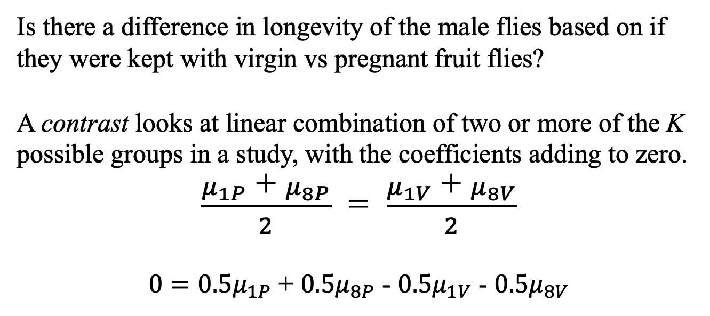
Fruit Flies Contrast
Is there a difference in longevity of the male flies based on if they were kept with virgin vs pregnant fruit flies?
A contrast looks at linear combination of two or more of the K possible groups in a study, with the coefficients adding to zero.
$\frac{μ_{1P}\text{ + }μ_{8P}}{2}$ = $\frac{μ_{1V}\text{ + }μ_{8V}}{2}$
$0=0.5μ_{1P}$ + $0.5μ_{8P}$ - $0.5μ_{1V}$ - $0.5μ_{8V}$
Note: A comparison is a special case of a contrast.

Slide 86
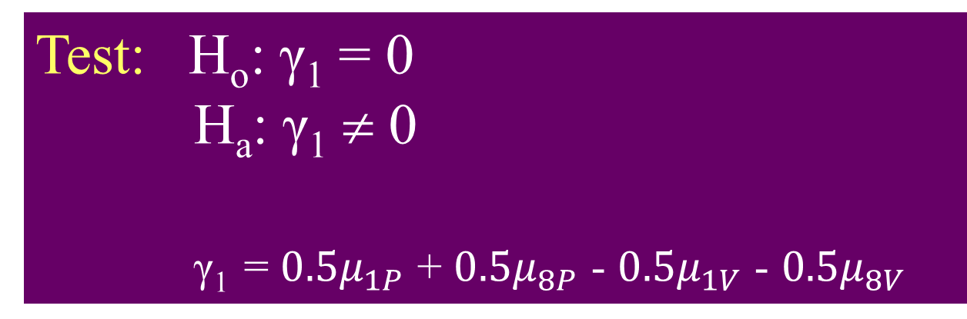
Fruit Fly Contrast
Test: H_{o}: γ₁ = 0
H_{a}: γ₁ ≠ 0
γ₁ = $0.5μ_{1P}$ + $0.5μ_{8P}$ - $0.5μ_{1V}$ - $0.5μ_{8V}$
summary(Fly.mod)
Df Sum Sq Mean Sq F value Pr(>F)
Treatment 4 11939 2984.8 13.61 3.52e-09 ***
Residuals 120 26314 219.3
Fly.MSE = summary(Fly.mod)[[1]][2,3]

